Slide 1
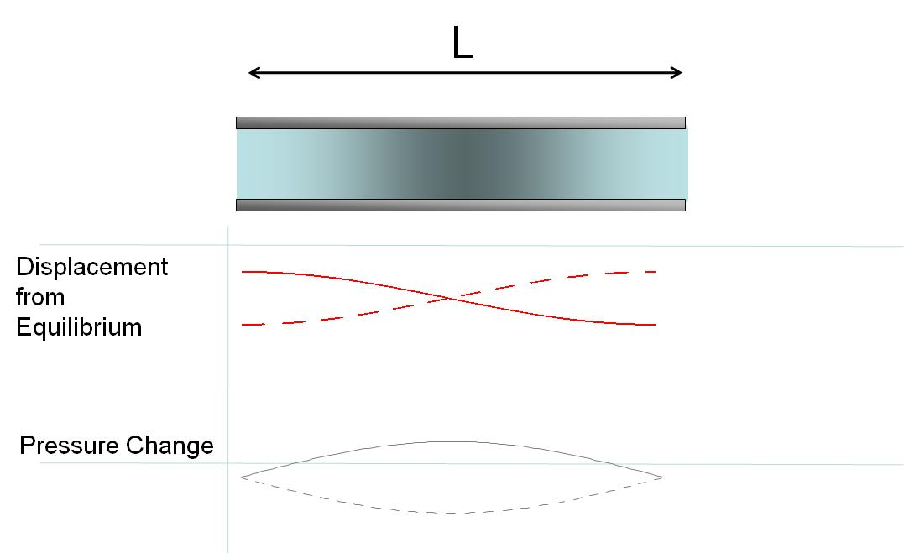
L
Displacement from Equilibrium
Pressure Change

Slide 2
L

Slide 3
L
Displacement from Equilibrium
Pressure Change

Slide 4
L

Slide 5
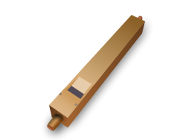

Slide 6
138.591Hz
155.563Hz
184.997Hz
207.652Hz
233.082Hz
277.183Hz
311.127Hz
369.994Hz
415.305Hz
D 146.832Hz
E 164.814Hz
F 174.614Hz
G 195.998Hz
A 220.000Hz
B 246.942Hz
C 261.626Hz
D 293.665Hz
E 329.628Hz
F 349.228Hz
G 391.995Hz
A 440.000Hz

Slide 7
A flash from a light bulb gets the wave started
Reflected wave is inverted and forms a standing wave
Mirrors

Slide 8
Partial mirror that lets some light out
Amplifier
Mirrors

Slide 9
Clamped Rod
The clamp prevents movement here
Atoms can move longitudinally here
Atoms can move longitudinally here

Slide 10
Clamped Rod: Center Clamp

Slide 11
Clamped Rod
The clamp prevents movement here
Atoms can move longitudinally here
Atoms can move longitudinally here

Slide 12
Clamped Rod: L/4 Clamp

Slide 13
Drum Head

